Slide 1

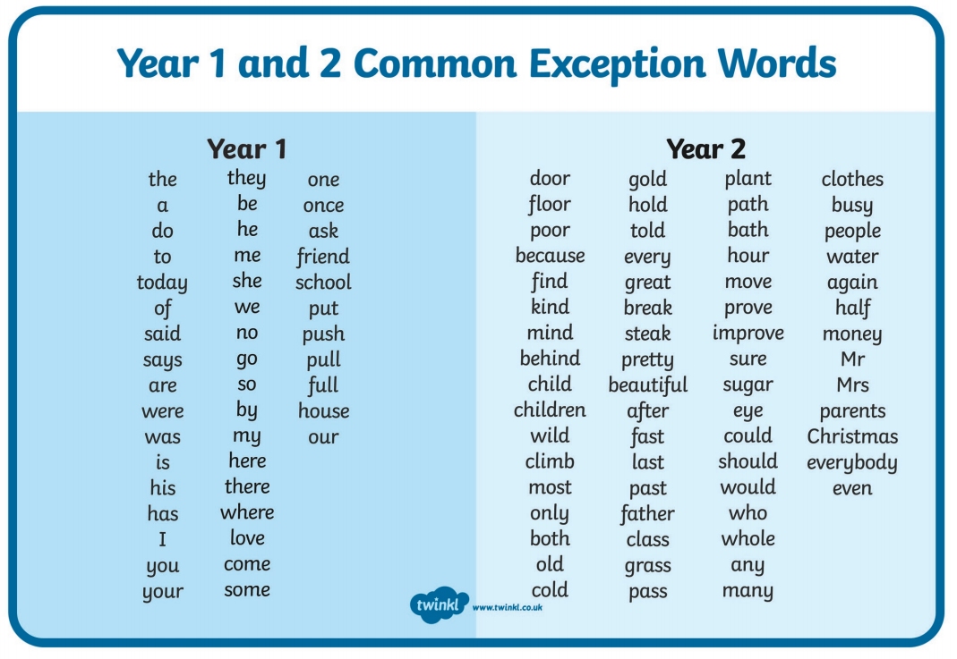
Common Exception Words
Year 1 and 2
Information for parents/carers

