Slide 1

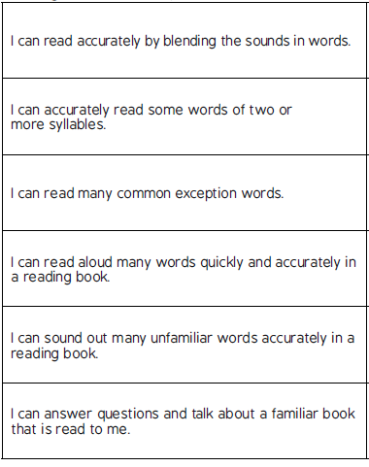
Reading
End of KS1 Expectations
Working Towards
Information for parents/carers

Slide 2
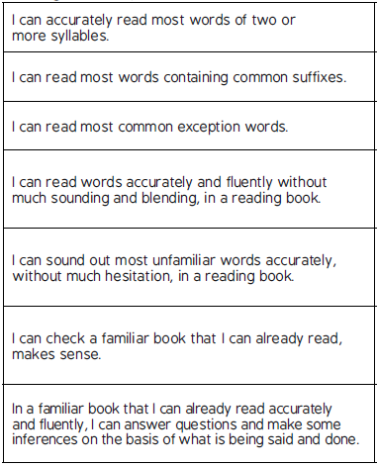
Reading
End of KS1 Expectations
Working At
Information for parents/carers

Slide 3
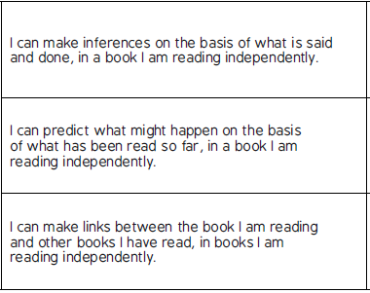
Reading
End of KS1 Expectations
Greater Depth
Information for parents/carers

